Slide 1


Online Job Circular Website
Presented By
1.MD. ATIKUR RAHMAN
(193311049)
2.MD. MONIRUZZAMAN PAVEL
(193311068)
3.MOST. SHAKILA KHATUN
(202311008)
Supervised by
Tokey Ahmmed
Lecturer
Department of cse
Varendra university

Slide 2
Introduction
Our online Job Circular Website will focus on job searching and recruitment.
It will help individuals to find employment opportunities and companies to identify suitable candidates.

Slide 3
Review of existing system and it’s problem
In our country existing system is bdjobs.com.
But there are 2 problems in this system.

Slide 4
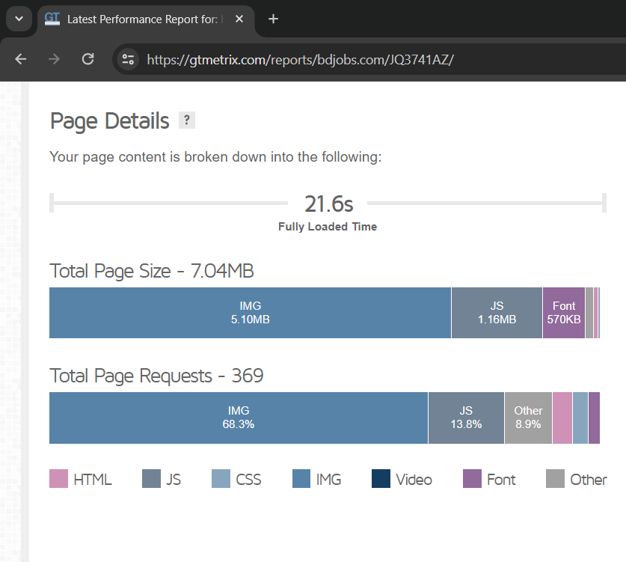
Problem 1 : It’s loading time is 21.6s!

Slide 5
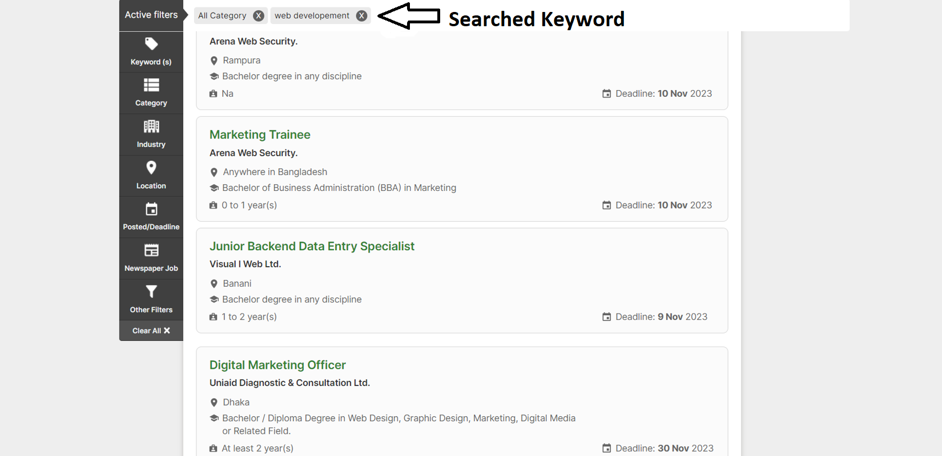
Problem 2: It’s showing irrelevant search result.

Slide 6
Key Challenges
Enhancing User Experience (UX)
Ensuring Data Security and Privacy
Optimizing Mobile Responsiveness
Implementing Quality Control for Job Listings

Slide 7
Features
User and Company Registration, Profile Creation and Dashboard
Job Posting, Searching and Listing
Skill Test
Resume Generate
Resume Upload
Apply to jobs
Application Tracking

Slide 8
Required Tools
Tools: Visual Studio Code, XAMP, GitHub
Front End : Html, CSS, Bootstrap, JavaScript
Back End: PHP
Database: SQL
Hosting: Amazon Web Service

Slide 9
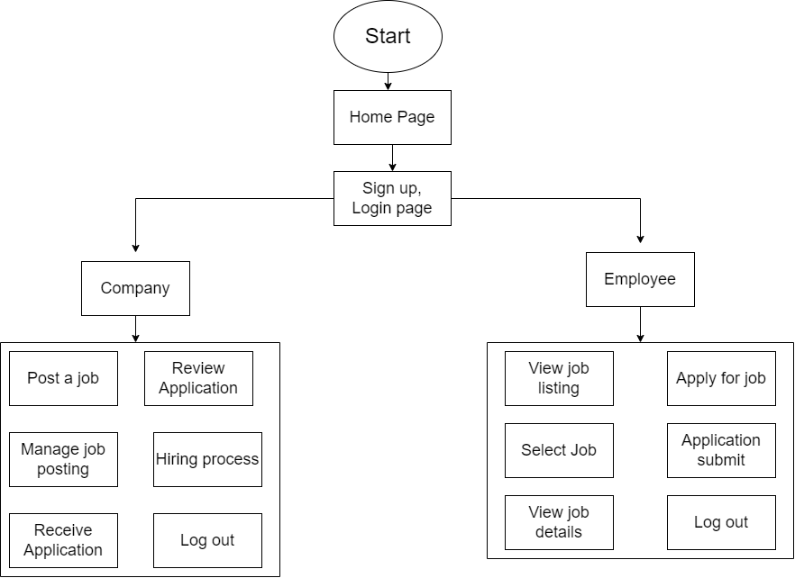
Flow Chart

Slide 10
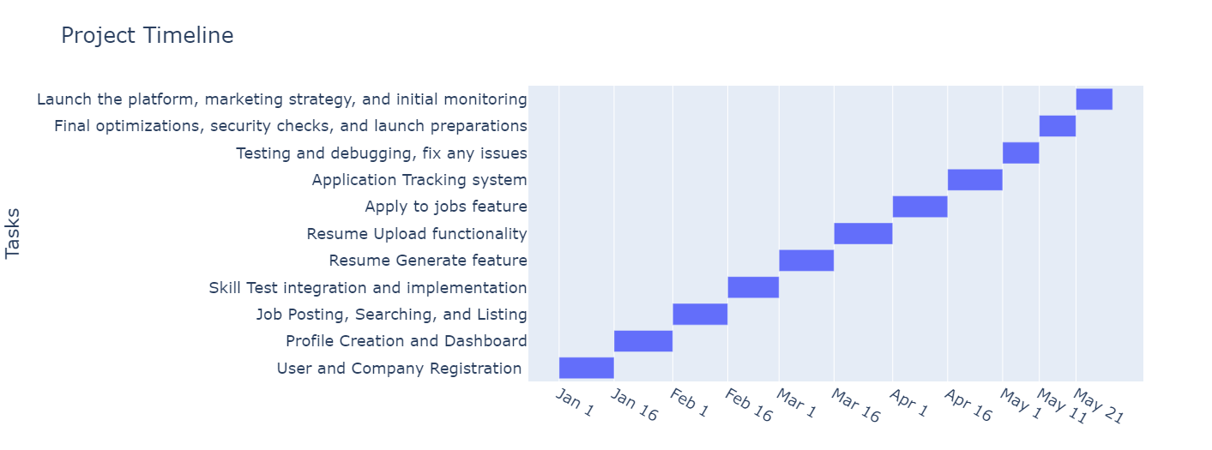
Time Frame
It will take approximately 5 months to complete the project.

Slide 11
Conclusion
The online job circular website serves as a crucial link between job seekers and employers.
Its user-friendly interface simplifies the job search process, providing targeted opportunities.
The platform's efficiency in connecting candidates with suitable positions contributes to a streamlined recruitment ecosystem.

Slide 12
References
[1] Website Performance Measure Tool – www.gtmetrix.com
[2] Page Load Time – www.sematext.com/glossary/page-load-time/
[3] https://www.browserstack.com/

Slide 13
Thank You

